Slide 1
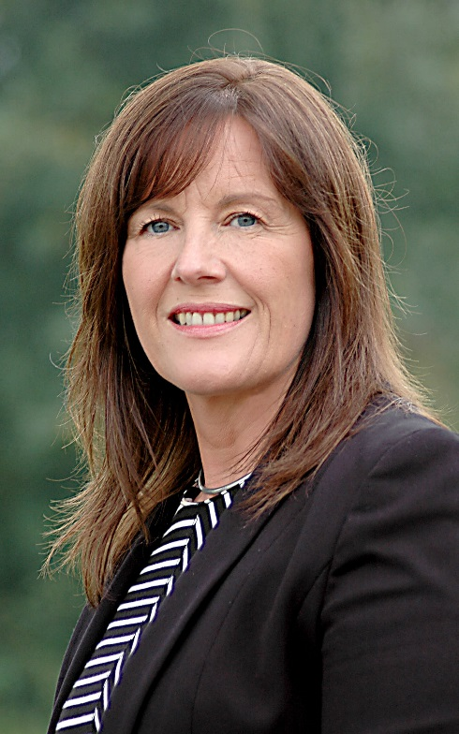
Welcome to Year 4

Slide 2
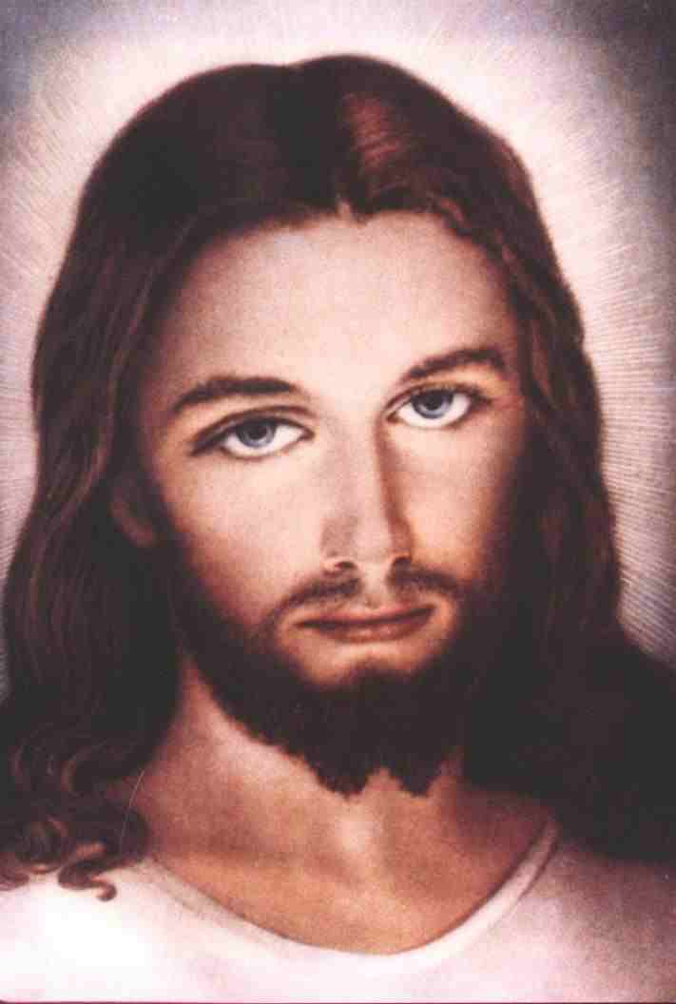
Religious Education in Year 4
Follow the Curriculum Directory set out by the Diocese
Children will lead weekly prayer services in class
Regular masses at school and whole school masses at St John Fisher Parish
Charity work
Chaplaincy team – 10 children from year 4

Slide 3
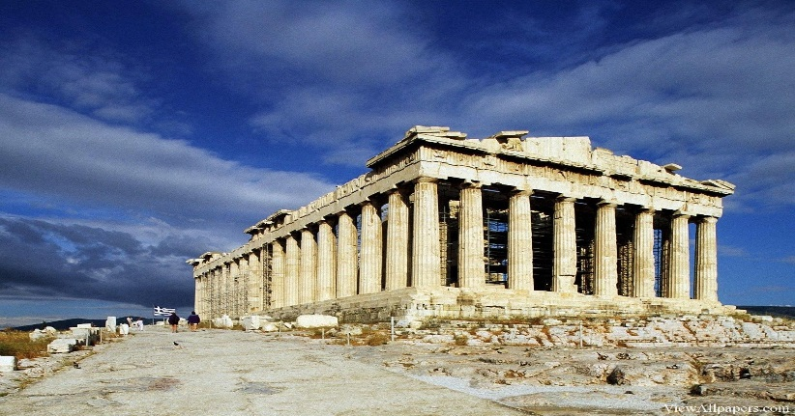
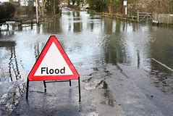
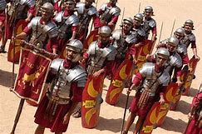
Thematic Curriculum
Autumn term – Ancient Greeks
Spring term – Water
Summer term - Romans

Slide 4
English
English is planned linked to the Thematic Curriculum eg Ancient Greece – Greek Myths.
Dedicated English lesson for teaching grammar and spelling
Separate lessons to teach reading skills
Partnership with parents – read daily with your children please
Children will have the opportunity to visit the school library however please use the local libraries.
Reading opens the door to everything……….
Handwriting

Slide 5
Maths
School uses the Maths no Problem scheme
Step by step progression of skills throughout all year groups
Fluency daily
Big focus for year 4 is Times Tables
Weekly homework given out on Friday and should be returned by Wednesday

Slide 6
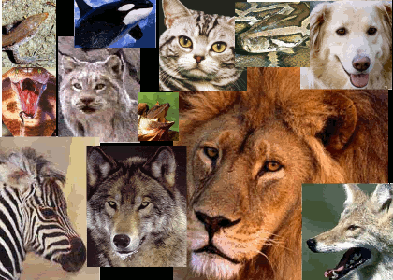
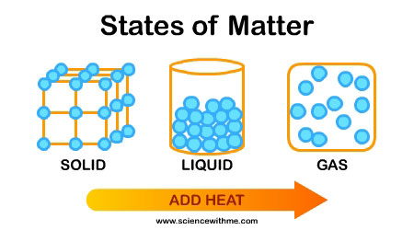
Science
Autumn term
Electricity
Animals including humans
Spring term
States of Matter
Summer term
Living things and their habitats
Sound

Slide 7
Physical Education
Year 3 swim in the Autumn term – please ensure they bring their kits
Children should have their PE in at all times
Please ensure your child doesn’t wear jewellery on the day they have PE
Extra curricular opportunities – variety of clubs
Trips
Children will have the opportunity to participate in school trips which will be linked to the Thematic Curriculum.
Pantomime at Christmas

Slide 8
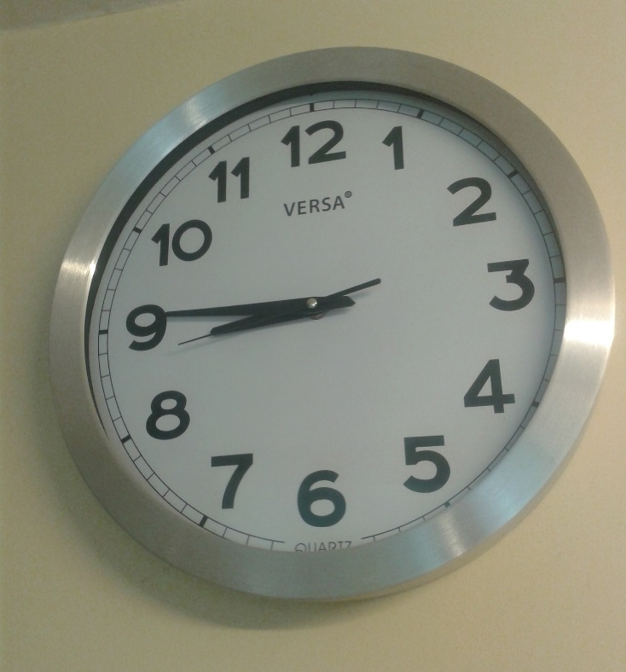
Make sure your child is in school on time every day. Every minute is a learning opportunity.
Attendance is key so think twice about keeping your child at home if they don’t need to be!
Wear your uniform with pride
School PE kit

